Slide 1
OBJECT ORIENTED PROGRAMMING
Class
Object
Getter & Setter

Slide 2
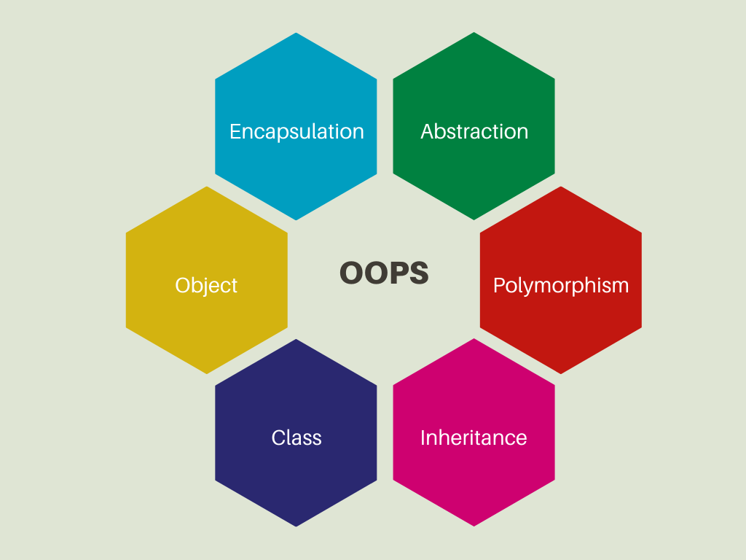
OOPS CONCEPT

Slide 3
CLASS FUNDAMENTALS
WHAT IS A JAVA CLASS?
It is a blueprint from which an object is created, that helps in defining the behaviour and properties of an object.
BUILT-IN CLASSES
USER-DEFINED/ CUSTOM CLASSES
HOW TO CREATE A CLASS IN JAVA?
<access specifier> class <classname>{
//classbody
}

Slide 4
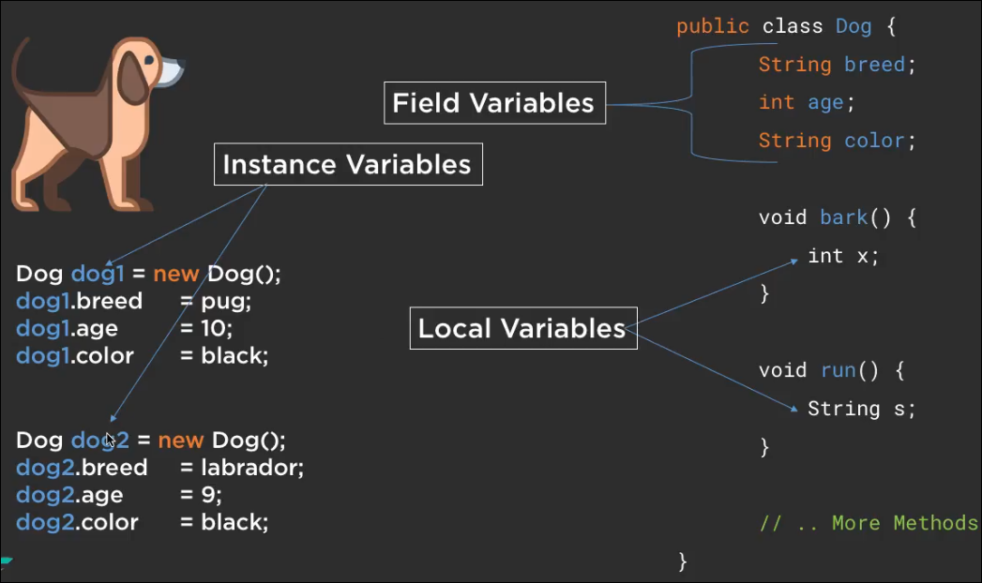

Slide 5
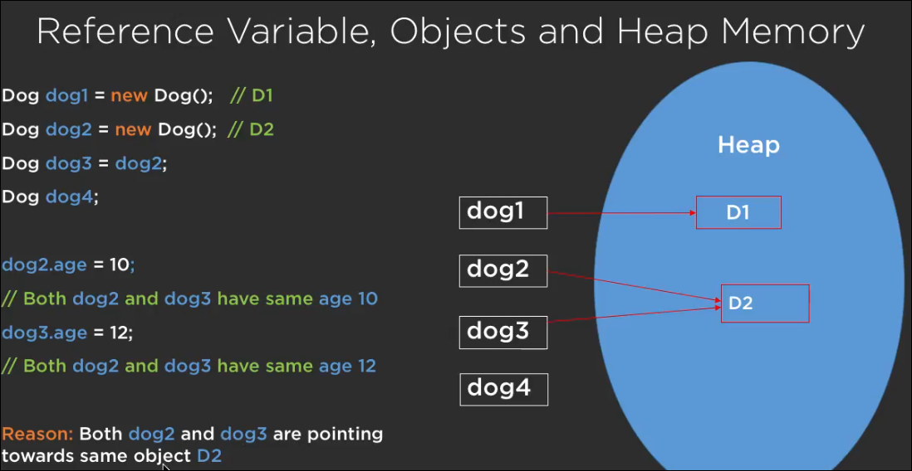

Slide 6

CLASS : A template or Blueprint that describes the
state of the object
Object : Object have state and behaviour and
it is called instance of class

Slide 7
RULES TO CREATE A CLASS
Must have the class keyword followed by the class name, and class must be followed by a legal identifier.
Class name must start with a capital letter and if you are using more than one word to define a class name, every first letter of the latter words should be made capital.

Slide 8
There should not be any spaces or special characters used in a class name except the dollar symbol($) and underscore(_).
Can only have public or default access specifier.

Slide 9
It can extend only one parent class. By default, all the classes extend java.lang.Object directly or indirectly.
A class may optionally implement any number of interfaces separated by commas.
The class’s members must be always declared within a set of curly braces {}.

Slide 10
Each .java source file can contain any number of default classes but can only have one public class.
Class containing the main() method is known as the Main class as it will act as the entry point to your program.

Slide 11
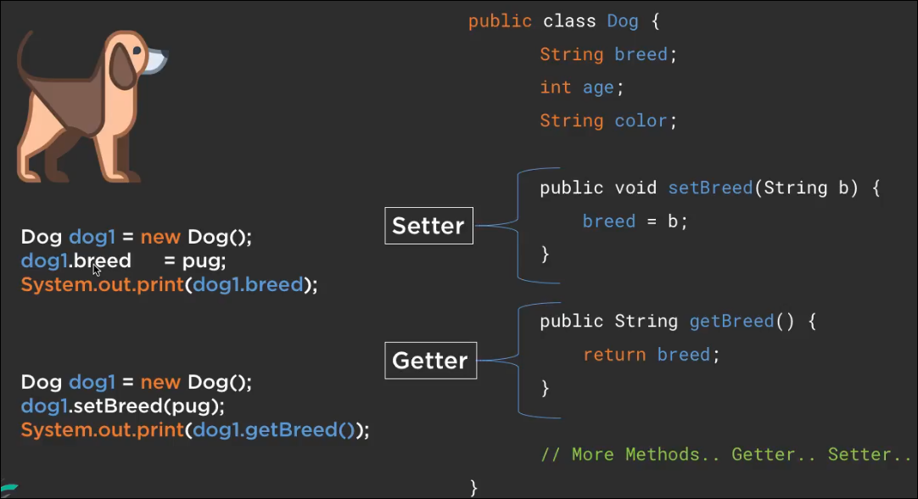
GETTER & SETTER

